Slide 1
Intel® Parallel Studio XE & Quantum Espresso
By – return 0;

Slide 2
Contents
Intel® Parallel Studio XE
Intel® VTune Profiler
Intel® Trace Analyzer and Collector
Quantum ESPRESSO

Slide 3

Intel® Parallel studio XE
Intel® Parallel Studio XE is a comprehensive tool suite of software development tools, developed by Intel, for compiling applications, optimizing performance and native code development in C++ and Fortran for parallel computing.

Slide 4
What does it include?
Parallel Studio is composed of several component parts, some of the most prominent include:
Intel C++ Compiler with OpenMP
Intel Fortran Compiler with OpenMP
Integrated Performance Primitives (IPP)
Math Kernel Library (MKL)
Threading Building Blocks (TBB)
Data Analytics Acceleration Library (DAAL)
Intel Advisor
Intel VTune Profiler
Intel Inspector
Intel MPI Library
Intel Trace Analyzer and Collector
Intel Cluster Checker
Intel Distribution for Python
The tools in your Intel® Parallel Studio XE suite combines industry-leading compilers, numerical libraries, performance profilers, and cluster tools to help you develop high-performance parallel code and accelerate workloads across enterprise, cloud, high-performance computing (HPC), and AI applications. The tools and libraries in each Intel® Parallel Studio XE suite were developed to make it simpler to build and modernize code with the latest techniques in vectorization, multithreading, multinode parallelization, and memory optimization.

Slide 5
Installation
We will be using the online installer package for Linux in this demo:
Run the install_GUI.sh script located at the top level of your installation archive. Read and accept the terms of the End User License Agreement (EULA) by selecting the corresponding radio button. Click the Next button to continue.
Choose whether you want to participate in the Intel® Software Improvement Program.
Review the Prerequisites dialog box to see whether your system is properly configured for the installation. You can proceed if you are missing optional prerequisites but, if you are missing any critical prerequisites, you need to fix them before you can continue. When you are done, click the Next button.
(You are required to select VTune, ITAC and Advisor)
Choose one of the activation options by selecting the corresponding radio button - Use existing license, use serial number to activate and install or choose alternative activation for offline activation. When done, click Next to continue.
Review the Installation Summary to see whether the selected installation options meet your needs. To proceed with the installation, click the Install button.
If applicable, review the list of the open-source components to be installed with this product. The Installation of Open Source Components dialog box displays your selection.
Click Next to start the installation. When all the selected components are installed, the Complete window is displayed.

Slide 6

Intel® Vtune Profiler
Intel VTune Performance Analyzer is a profiling tool for software performance analysis for C, C++, and Fortran code which detects performance bottlenecks (hotspots) in an application by identifying where in the code, time is being spent. It is targeted for users developing sequential and multithreaded applications on 32 and 64-bit x86 based machines and helps you analyse the algorithm choices and identify where and how an application can benefit from available hardware resources thus helping in optimizing software.

Slide 7
Code Optimisation Features
VTune Profiler assists in various kinds of code profiling including stack sampling, thread profiling and hardware event sampling. The profiler result consists of details such as time spent in each sub routine which can be drilled down to the instruction level. The time taken by the instructions are indicative of any stalls in the pipeline during instruction execution. The tool can be also used to analyze thread and storage performance.
Software sampling - Gives both the locations where time is spent, and the call stack used.
Locks and waits analysis - Finds long synchronization waits that occur when cores are underutilized.
Threading timeline - Shows thread relationships to identify load balancing and synchronization issues.
Source view - Sampling results are displayed line by line on the source / assembly code.
Hardware event sampling - Finds specific tuning opportunities like cache misses and branch mispredictions.
Memory Access Analysis - Tune data structures for performance and optimize NUMA latency and scalability.
Storage Analysis - Tune interplay of I/O and compute.
Languages - C, C++, C#, Fortran, Java, Python, Go, OpenCL, assembly and any mix.

Slide 8
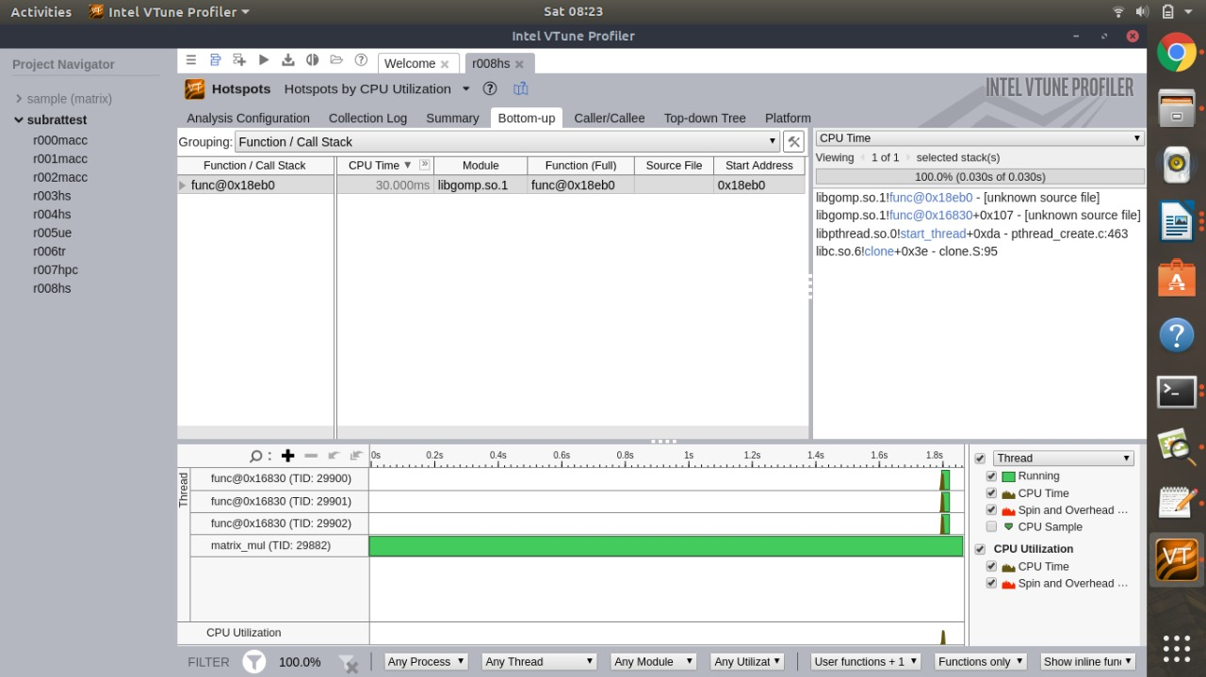
Usage

Slide 9
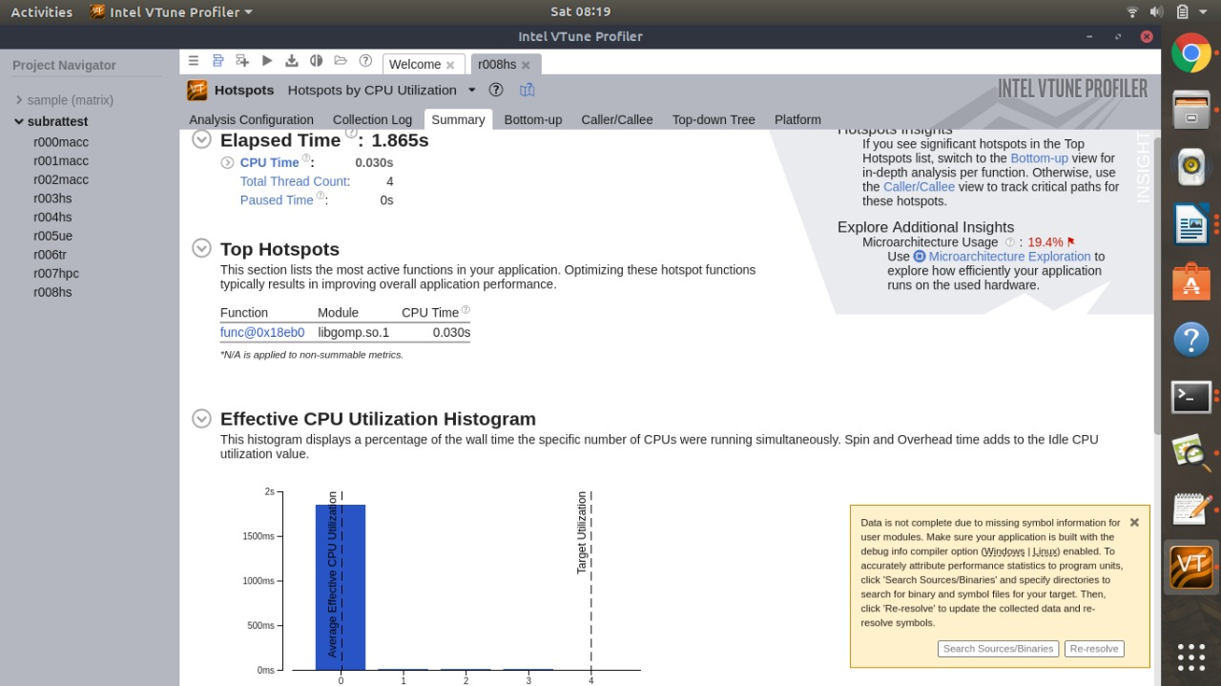
Usage

Slide 10
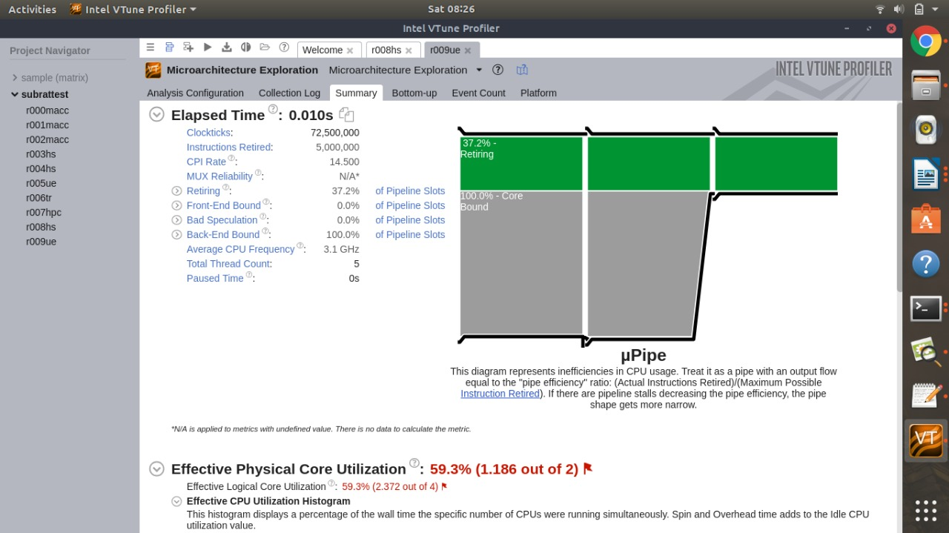
Usage

Slide 11
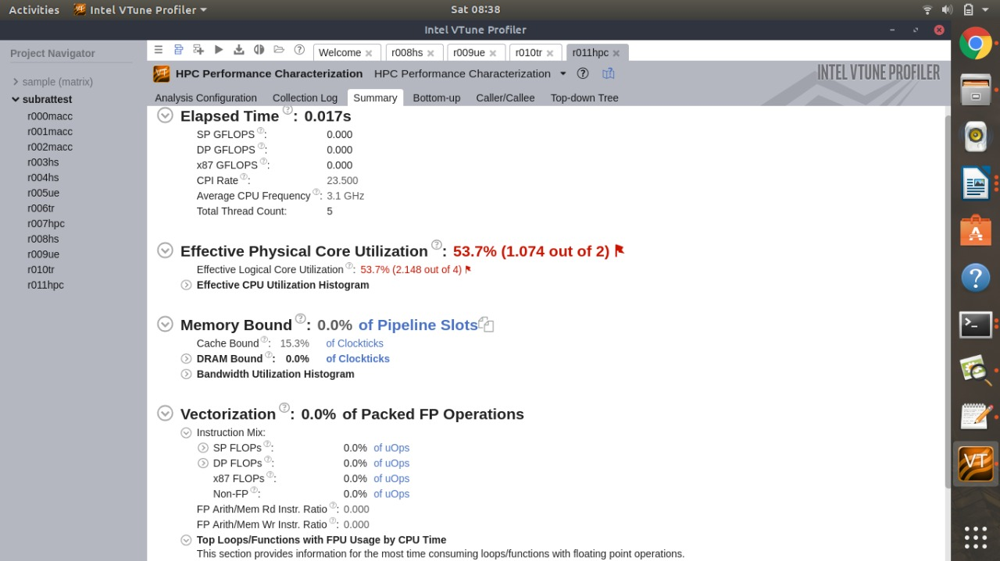
Usage

Slide 12
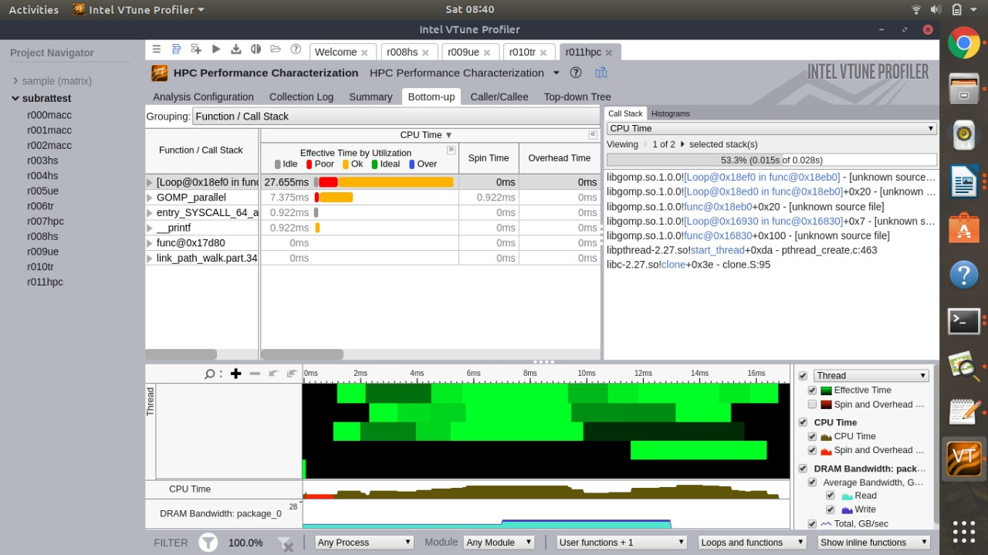
Usage

Slide 13
Intel® Trace Analyzer And Collector
Intel® Trace Analyzer and Collector is a graphical tool combo for understanding MPI application behaviour, quickly finding bottlenecks, improving correctness, and achieving high performance for parallel cluster applications across their full runtime.
Intel® Trace Collector is a tool for tracing MPI applications and enables you to collect statistics for your applications. It intercepts all MPI calls and generates traceries, that can be analysed with the Intel Trace Analyzer for understanding the application behaviour. Intel® Trace Analyzer provides powerful capabilities for visualizing and analysing the collected data. Intel Trace Collector can also trace non-MPI applications, like socket computer in distributed applications or serial programs.

Slide 14
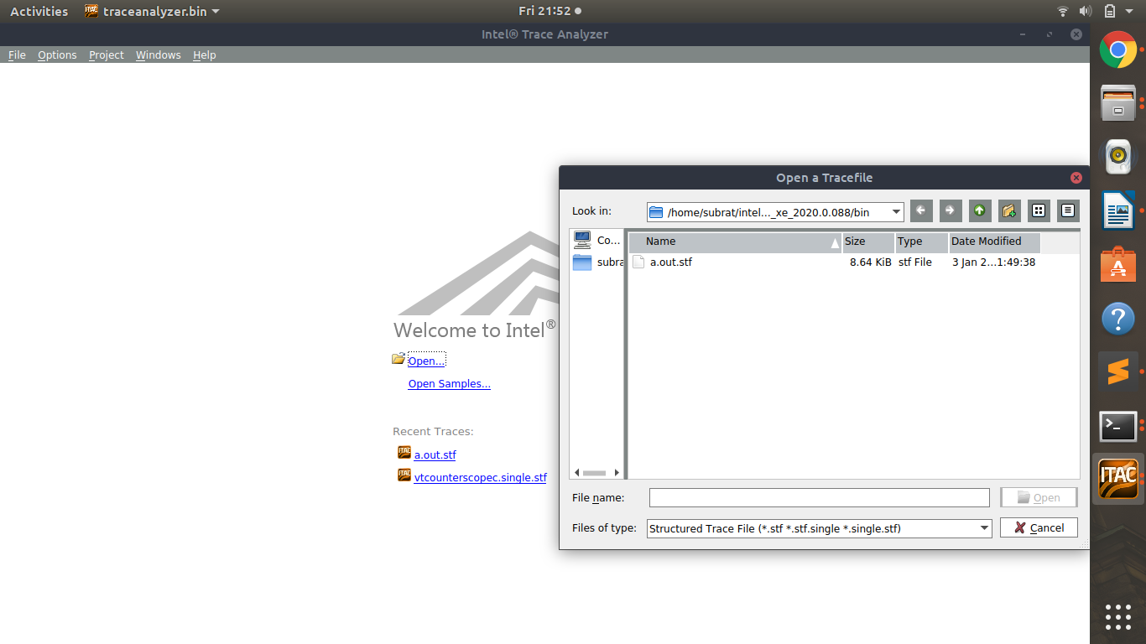
Usage

Slide 15
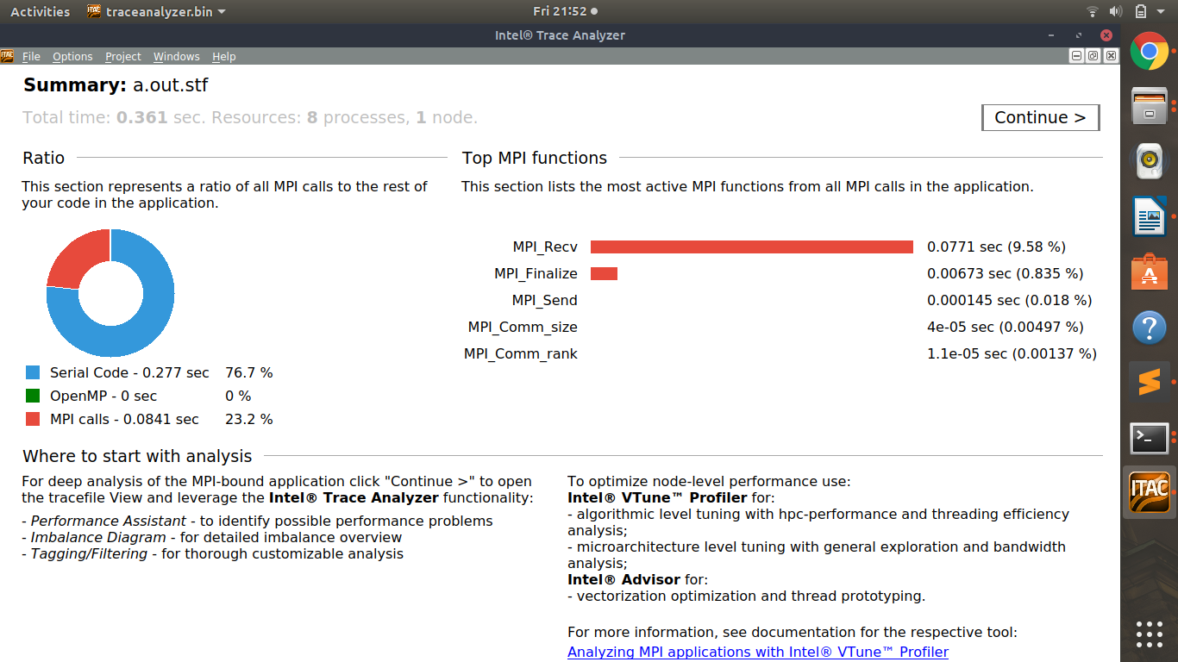
Usage

Slide 16
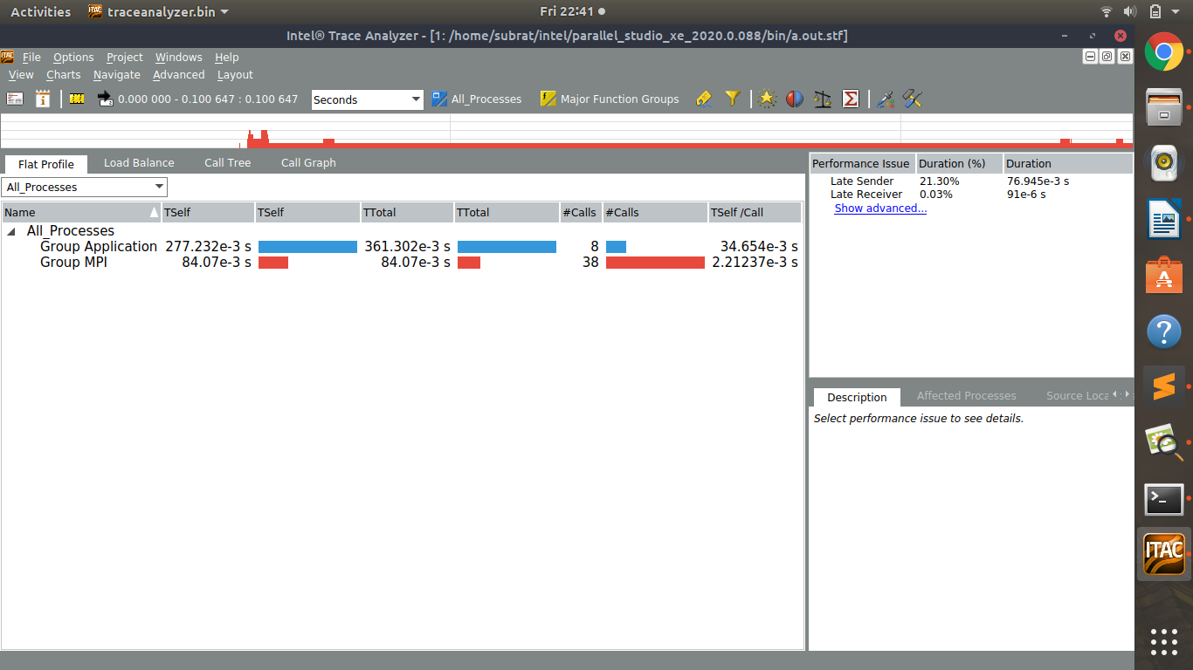
Usage

Slide 17
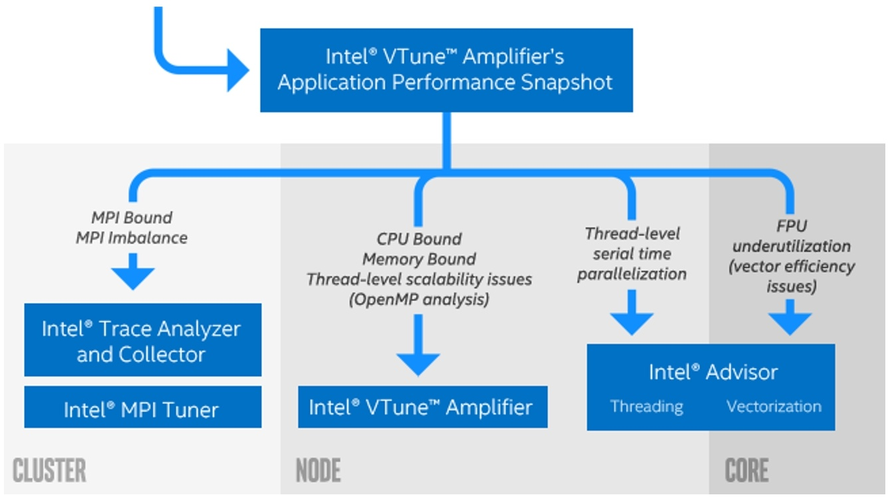
What is the difference?
Basics of when and which of the tools provided should be used to better optimize an application and/or mitigate bottlenecks in code.

Slide 18

Quantum ESPRESSO
Quantum ESPRESSO is a suite for quantum chemistry methods of electronic-structure calculation and materials modeling. ESPRESSO is an acronym for opEn-Source Package for Research in Electronic Structure, Simulation, and Optimization.

Slide 19
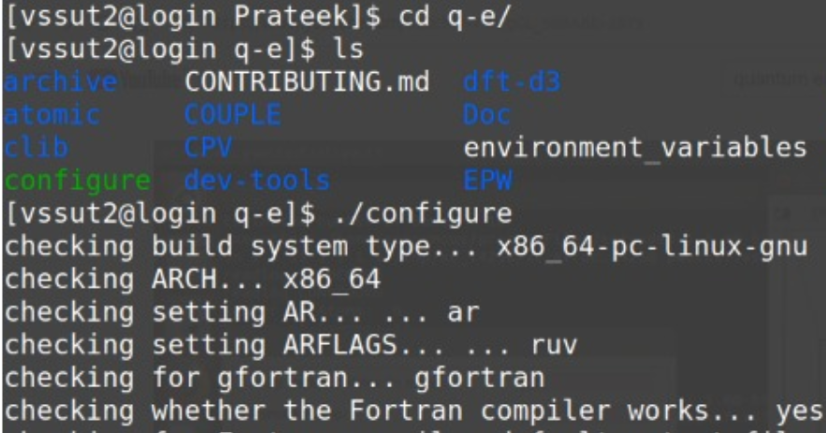
Installation
We will be using the online installer package for Linux in this demo:
Make sure you have done a recent system install of a C & Fortran compiler, that the compiler is in the system PATH and that it is up to date.
Prepare to run the configure script located at the top level of your installation archive using ./configure command
Add the necessary arguments to this configure command. Example: For OpenMP executables, specify ./configure -enable-openmp.
Execute the command make all to utilize the newly created make.inc file

Slide 20
Input, Pseudopotential & Output files
Cu.in file link: https://drive.google.com/file/d/1_BLyHKM5CR9eNflWnNzUcgh-NoAlOraM/view?usp=sharing
Cu.pbesol-dn-kjpaw_psl.1.0.0.UPF file link: https://drive.google.com/file/d/1xrxUlJiV-z8i1JG-at18EAFqKW4JOCjQ/view?usp=sharing
Cu1node.out file link: https://drive.google.com/file/d/1vYQHszLOMZG4cv9Bvajc8TWgTK25XqbM/view?usp=sharing
Cu8node.out file link: https://drive.google.com/file/d/1VoM2bq2fqaRUon1lXh-jb6YAIcqSUHCH/view?usp=sharing
Cu16node.out file link: https://drive.google.com/file/d/13sojjNoQYXEQq9sfWspTK2HWSmRkQW8g/view?usp=sharing

Slide 21
Parallelization
The program, written mainly in Fortran-90 with some parts in C or in Fortran-77, was built out of the merging and re-engineering of different independently-developed core packages, plus a set of packages, designed to be inter-operable with the core components, which allow the performance of more advanced tasks.
The main components of the QUANTUM ESPRESSO distribution are designed to exploit the architecture of today’s supercomputers characterized by multiple levels and layers of inter-processor communication . The parallelization is achieved using both MPI and OpenMP parallelization, allowing the main codes of the distribution to run in parallel on most or all parallel machines with very good performance.

Slide 22
Thank You
By – return 0;

